Slide 1

Project On
Airbnb Property Management Optimization
Presented By: Satendra Singh Katewa

Slide 2
Project Overview
Airbnb Property Management Optimization
You are working as a Data Analyst at Airbnb, a leading online marketplace connecting travelers with unique accommodations worldwide. Airbnb is committed to helping property owners maximize their revenue while delivering exceptional guest experiences.
-------------------------------------------------------------------------------------------------------------------------------------------------------------------------------------------------------
Problem Statement: Airbnb aims to develop a comprehensive Tableau dashboard to:
Optimize rental strategies based on property type, location, and seasonality.
Enhance customer satisfaction by aligning listings with guest preferences.
Maximize revenue for property owners through data-driven insights.
Your role is to analyze Airbnb’s extensive dataset and uncover valuable patterns and trends that empower better decision-making for both Airbnb and its hosts.

Slide 3
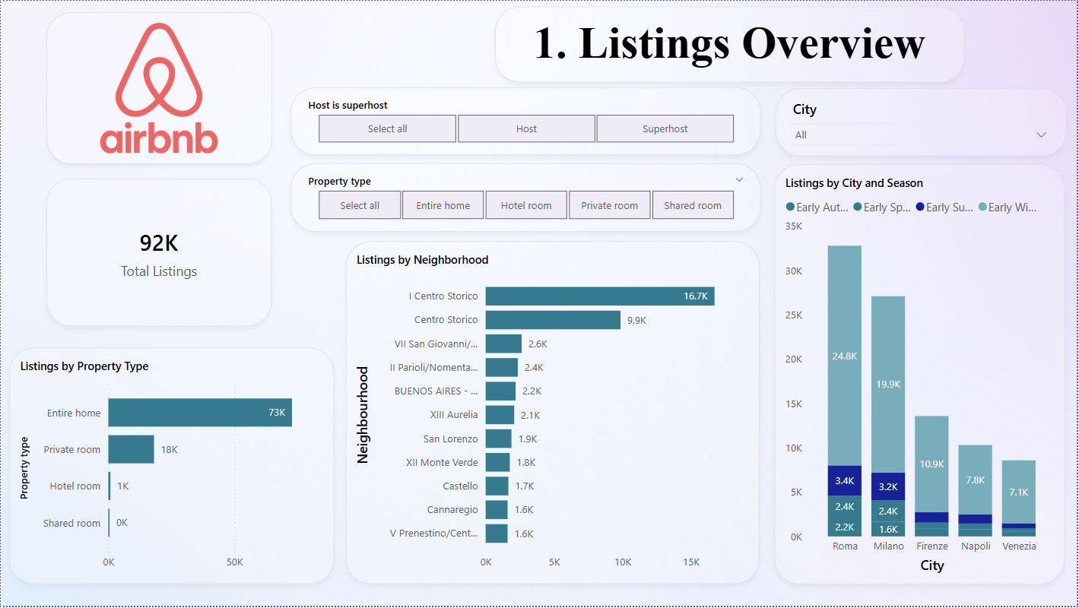

Slide 4
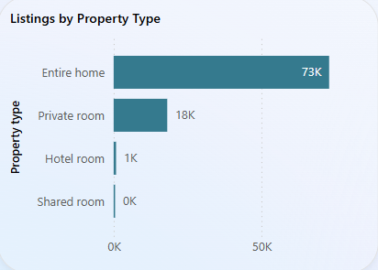
1. General overview ----------------------------------------------------------------------------------------------------------------------- Total listings: There are 92,000 airbnb listings in the dataset. Dominant property type: The overwhelming majority are entire home listings (73,000, ~79% of all listings). Private rooms account for 18,000 (~20%). Hotel rooms are marginal (1,000), and shared rooms are negligible. This distribution indicates a strong preference among hosts to offer entire properties rather than shared accommodations. Seasonal trends: Seasonal demand significantly varies across cities. For example, rome sees its peak volume in early autumn with 24,800 listings, while early summer and early spring have substantially fewer listings (~3,000 each). Similar seasonality patterns are visible in milan and other major cities, implying opportunities to adjust pricing strategies seasonally.

Slide 5
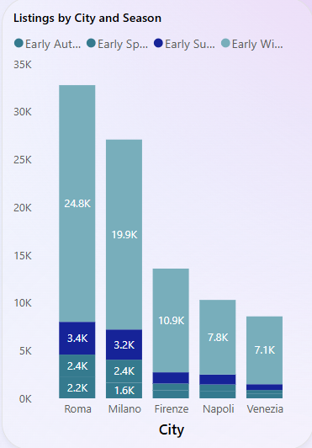
2. City-level insights ----------------------------------------------------------------------------------------------- Top Cities by Listing Volume: Rome: ~33,000 listings, the largest market. Milan: ~27,000 listings. Firenze (Florence): ~11,000 listings. Napoli: ~8,000 listings. Venezia: ~7,000 listings. Rome & Milan Combined represent ~65% of the total listings. The relatively lower listing counts in cities like napoli and venezia suggest potential growth markets compared to rome and milan, which are more mature

Slide 6
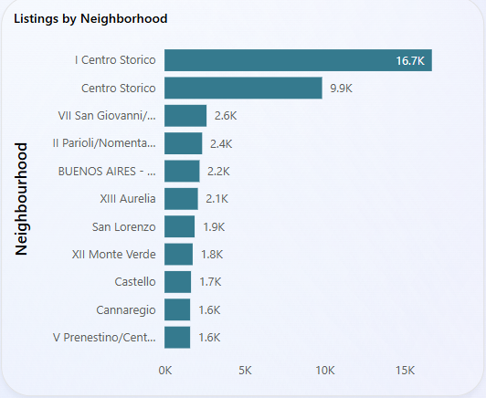
3. Neighborhood-Level Insights --------------------------------------------------------------------------------------------------------------- Top neighborhoods: I Centro storico: 16,700 listings, the highest-concentration neighborhood. Centro storico: 9,900 listings. Other notable neighborhoods include: VII san giovanni (~2,600) II parioli/nomentano (~2,400) BUENOS AIRES – venezia (~2,200) These figures highlight that listings are heavily clustered in central historic districts, catering to tourists seeking proximity to attractions. Opportunities: While central areas dominate, secondary neighborhoods (1,500–2,500 listings) show viable interest and could be targeted for differentiated offerings or more affordable options.

Slide 7
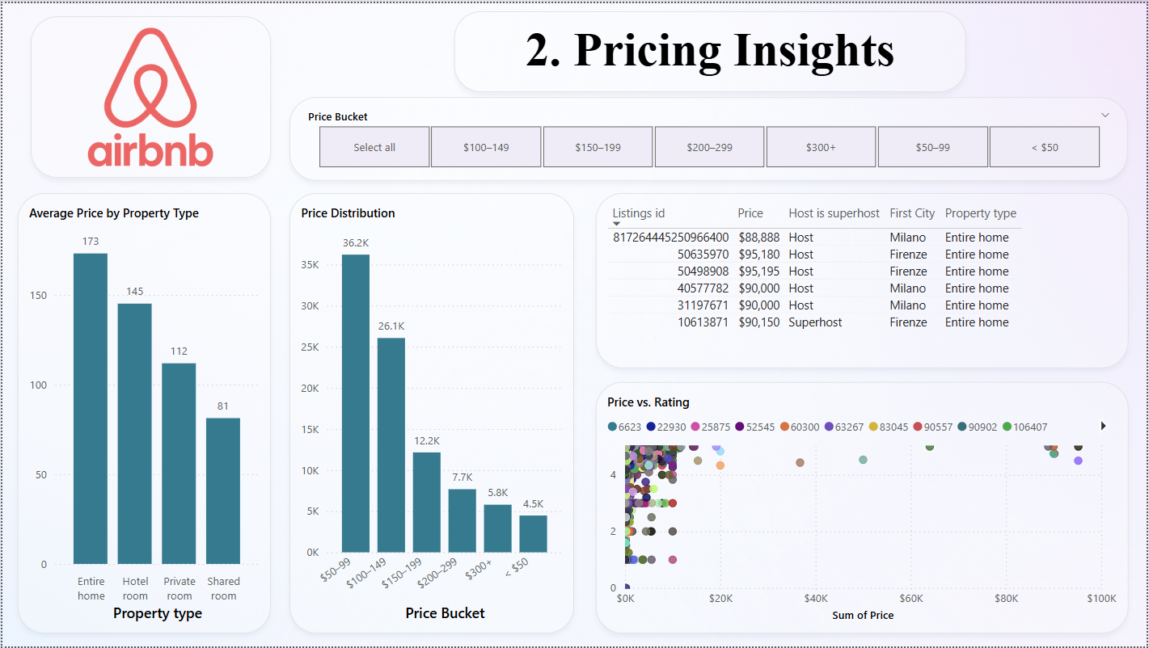

Slide 8
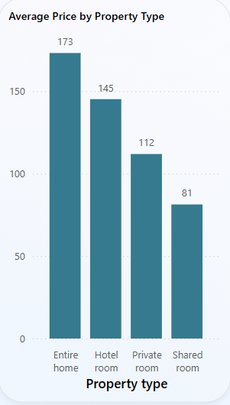
Pricing Insights
-----------------------------------------------------------------------------
This dashboard provides a clear view of Airbnb pricing trends by property type and price distribution.
Average Price by Property Type:
Entire homes have the highest average price at $173.
Hotel rooms follow at $145, while private rooms average $112.
Shared rooms are the most affordable at $81.
This shows that guests are willing to pay more for privacy and space.
Price Distribution:
The majority of listings fall into the $50–99 range (36.2K listings).
The second largest group is $100–149 with 26.1K listings.
Listings priced above $300 are fewer, showing limited high-end inventory.

Slide 9
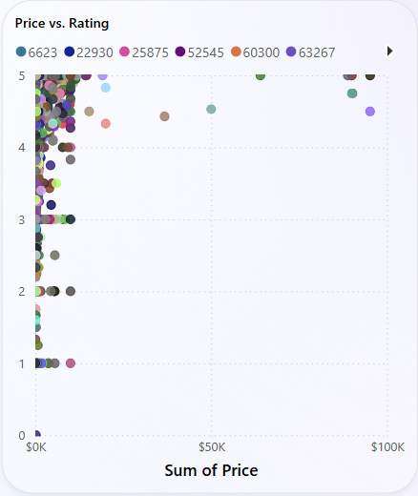
Pricing Insights
-----------------------------------------------------------------------------
Top Listings by Price:
High-priced listings reach up to $95,000+, mainly in Milano and Firenze, and are typically entire homes.
These listings are hosted by both hosts and superhosts, indicating that both new and experienced hosts operate in the luxury segment.
Price vs. Rating:
Most listings with high prices cluster at lower ratings.
This may indicate a need for quality improvements in premium-priced properties or better guest experience management.
Summary: Airbnb hosts can maximize revenue by offering entire homes and strategically pricing between $50–149, which covers most of the market demand. High-priced listings should focus on enhancing guest satisfaction to match pricing expectations.

Slide 10
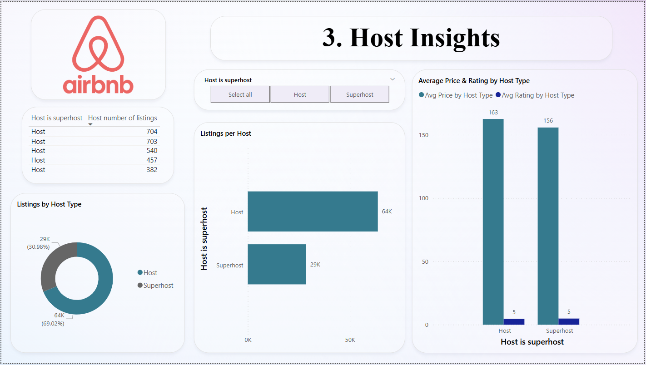

Slide 11
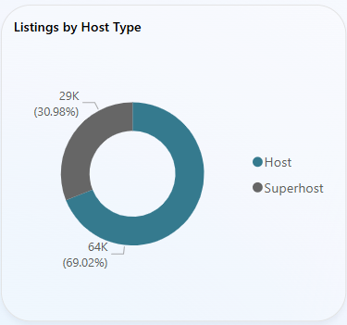
Host insights -------------------------------------------------------------------------------------------- This dashboard shows how listings are distributed between regular hosts and superhosts and how their pricing and ratings compare. Listings by host type: Regular hosts manage the majority of listings (64K, 69%). Superhosts account for 29K listings (31%). This indicates that most properties are managed by non-superhost accounts. Top hosts by number of listings: Some hosts manage large portfolios, with the highest having 704 listings. The top 5 hosts each manage over 380 listings, suggesting a strong presence of professional property managers.

Slide 12
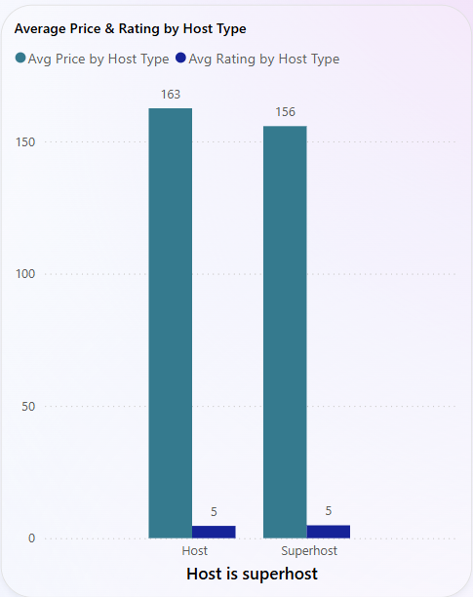
Host insights -------------------------------------------------------------------------------------------- Average price and rating by host type: Regular hosts have an average price of $163. Superhosts have a slightly lower average price of $156. Both host types maintain the same average rating of 5, indicating consistently high guest satisfaction. Listings per host: There is a significant gap between the number of listings managed by hosts versus superhosts. Hosts are more dominant in volume, while superhosts focus on fewer, high-quality listings. Summary: Most airbnb properties are managed by regular hosts, who also tend to set slightly higher prices. Superhosts, although fewer in number, maintain equally high guest ratings, highlighting their focus on quality and service.

Slide 13
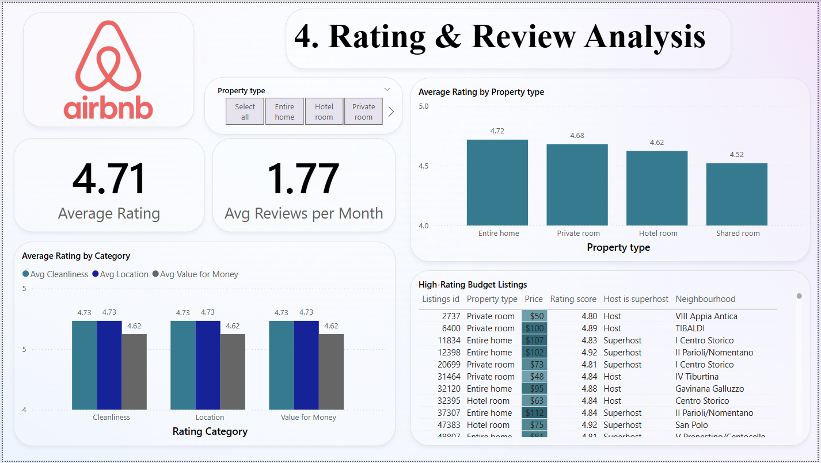

Slide 14
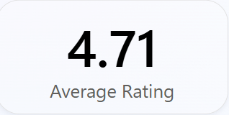
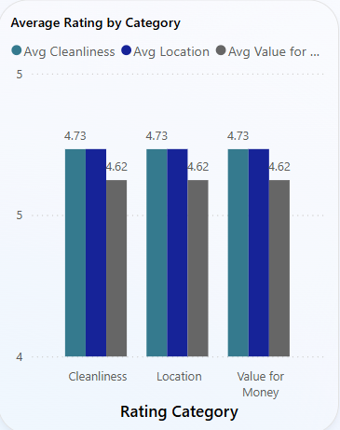
Rating & Review Analysis
-----------------------------------------------------------------------------
This dashboard analyzes customer feedback through ratings and review activity across different property types.
Overall Ratings:
The average rating across listings is 4.71.
On average, each listing receives about 1.77 reviews per month, indicating consistent guest engagement.
Average Rating by Property Type:
Entire homes receive the highest average rating (4.72)
Private rooms follow with 4.68, while hotel rooms and shared rooms have slightly lower ratings at 4.62 and 4.52, respectively.

Slide 15
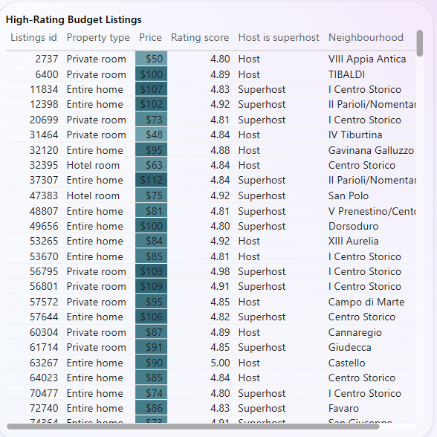
Rating & Review Analysis
-----------------------------------------------------------------------------
Category Ratings:
Cleanliness and location both score 4.73 on average.
Value for money is slightly lower at 4.62, suggesting a potential area of improvement.
High-Rating Budget Listings:
Several listings offer both high ratings (above 4.8) and budget-friendly prices (as low as $48–$112).
These are mainly private rooms and entire homes hosted by both hosts and superhosts across various neighborhoods.
Summary: Guests rate their stays highly overall, especially for cleanliness and location. Entire homes tend to receive the best feedback. Budget options with excellent ratings show that affordability doesn’t necessarily compromise guest satisfaction.

Slide 16
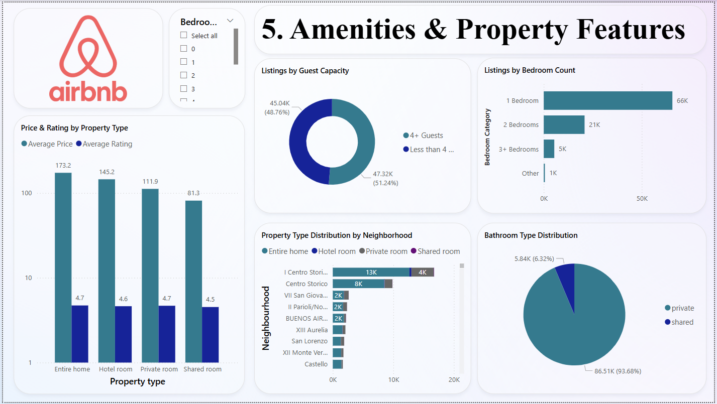

Slide 17
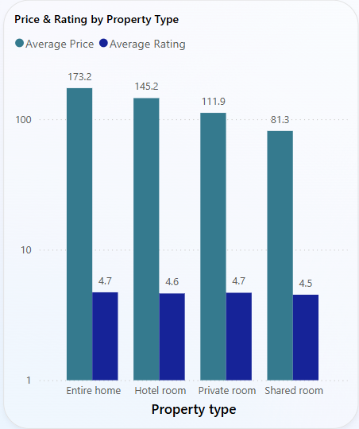
Amenities & Property Features -------------------------------------------------------------------------------------------- This analysis explores property characteristics, capacity, and amenities across listings. Price & rating by property type: entire homes have the highest average price ($173.2) and a strong average rating (4.7). Shared rooms are the most affordable ($81.3) but have slightly lower ratings (4.5). Guest capacity: listings are fairly balanced: 51% host fewer than 4 guests 49% can accommodate 4+ guests

Slide 18
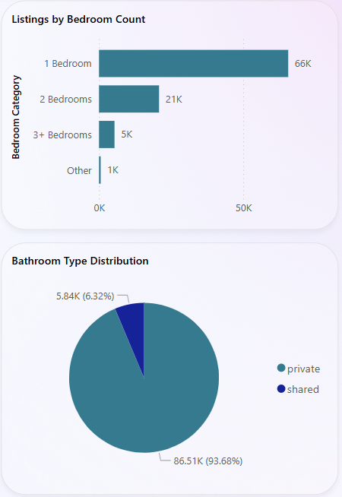
Amenities & Property Features -------------------------------------------------------------------------------------------- Bedroom count: 1-bedroom listings dominate (66K). 2-bedroom (21K) and 3+ bedrooms (5K) are less common. Bathroom type: the vast majority (93.7%) offer private bathrooms, indicating a preference for more private amenities. Neighborhood distribution: I centro storico and centro storico have the highest concentrations of listings. Private and entire homes are the most common property types across neighborhoods. Summary: listings tend to favor smaller properties with private bathrooms. Entire homes command higher prices but maintain strong ratings, while shared spaces remain the budget-friendly option.

Slide 19
Conclusion
---------------------------------------------------------------------------------------------------------------------------------------------
Hosts: Regular hosts hold 69% of listings; Superhosts maintain higher ratings but charge similar prices—indicating untapped pricing potential.
Property Types: Entire homes lead in both price ($173) and rating (4.7), while shared rooms are lowest on both fronts.
Guest & Amenity Preferences: Majority of listings are 1-bedroom, with 93% offering private bathrooms—showing a clear preference for private, compact spaces.
Ratings & Reviews: Cleanliness and location are top-rated (4.73), but average reviews per month (1.77) are low, signaling a need for stronger guest engagement.
Neighborhood Hotspots: Listings are concentrated in central areas like Centro Storico, ideal for pricing and promotion focus.
Strategic Focus: Promote Superhost conversion, enhance pricing on high-rated listings, and invest in guest experience initiatives.

Slide 20
Thank you
Satendra Singh Katewa
LinkedIN: SSK_LinkedIN
satendarsinghkatewa123@gmail.com
GitHub: satendrakatewa

